Slide 1
Workshop on Data Management
A primer on modern data management technologies and use of Python to handle data
Dunstan Matekenya, Data Scientist, World Bank Group
August 10, 2022

Slide 2

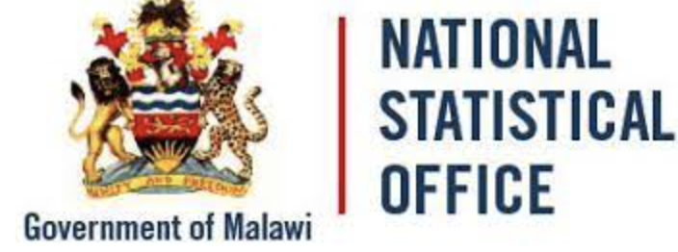


About Me
PhD research-Big Data
Freelance Data Scientist
Part-time ML Engineer-Startup
Data Scientist, WBG
Mobile phone data and development
Machine learning and other ad hoc DS work
Teaching DS with AIMS in Rwanda
B.Ed (Mathematics)
Statistician, NSO, Malawi
Statistician with focus on GIS
2001-2006
2007-2008
2009-2013
2014-2016
2017-Present

Slide 3
Outline
Prep-software installation
Exploring data management
A tour of Python tools for data science-hands on exercises
0-30 minutes
30-60 minutes
60-150 minutes

Slide 4

What is Data Management?

Slide 5
No single definition, so lets poll the experts
Data Management is a group of activities, technologies/infrastructure and practices relating to the planning, development, implementation and administration of systems for the acquisition, storage, security, retrieval, dissemination, archiving and disposal of data.

Slide 6
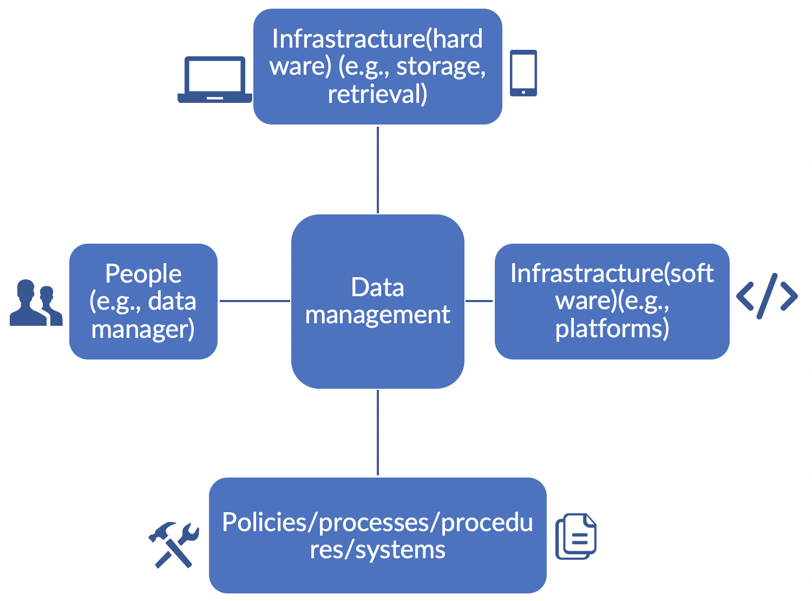
Data Management Key Components
Policies/practices/processes apply to different stages of the data value chain
For example, an organization need policies and practices for the following:
Data collection
Metadata generation
Data quality assessments and control
Data access and dissemination
Data security
Infrastructure choices influence data management
Software capabilities determine what you can and cannot do
Hardware capacities determine how much data you can store and for how long
Having dedicated persons focusing on data management often leads to better results
Ensuring people handling data know DM best practices and organization rules
Key components of data management(DM)

Slide 7
(Mostly) Obvious Benefits for Good Data Management Practices
Benefits to the organization
Benefits to external data providers
Benefits to consumers
Improved business processes, including better and more efficient use and re-use of data.
Avoiding re-collecting same data
Better quality, harmonized and coherent data from the use of common definitions, formats, validation processes and standard procedures.
An increased confidence and trust that their data will be used according to their agreed conditions of use, without risk to confidentiality or privacy violations
Providing a clear understanding of the use of their data, formally documented in a MoUs
A fair return for the use of the data they have supplied.
Easier data discoverbility
An increased confidence and trust that their data will be used according to their agreed conditions of use, without risk to confidentiality or privacy violations
Providing a clear understanding of the use of their data, formally documented in a MoUs

Slide 8
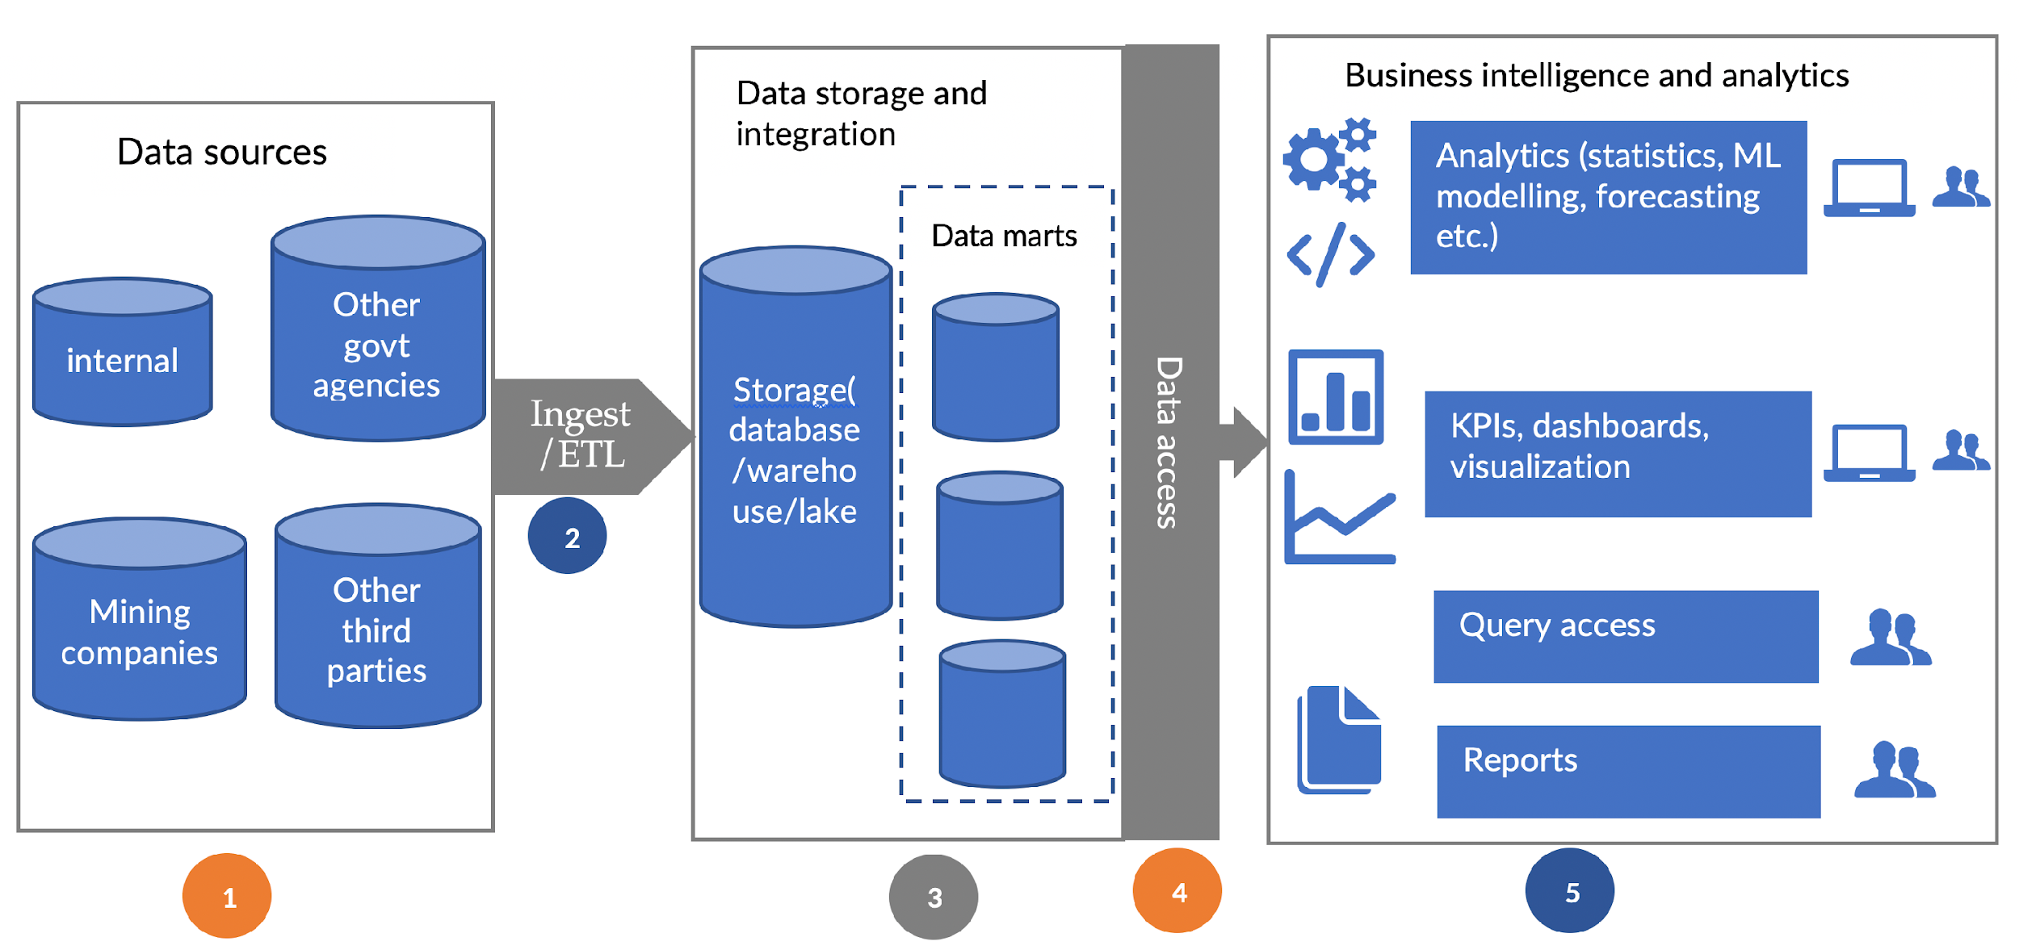
Looking at Data Management through a Typical Data Architecture or Value Chain
Data management practices apply across all the stages from 1-5

Slide 9
Data Management Practices When Accessing/Collecting Data
1
Important Principles to Keep in Mind
Avoid re-collecting data. One way is to have a data catalogue of existing data. What else could help here?
Data ownership. During data access/collection phase, its important to be clear who owns the data
Metadata. Ensure the organization has metadata standards/framework that it uses. For example, for geospatial data, we have ISO specification for metadata. What does NMA use?
What about data provenance?
Data quality. This applies to all stages including this one
All these components play a role but our main focus is on policies

Slide 10
Data Management Practices When Accessing Data-Ingesting/ETL
2
Important Principles to Keep in Mind When Ingesting Data from other Sources
This mostly applies to data being routinely accessed from third parties (e.g., mining companies)
Ensure there is proper documentation for all processing being done to the data before ingesting it into your system
Emphasize on reproducible workflows.
For example, use version control software such as GitHub to help with above. How many of you are familiar with Git and GitHub or any version control system?
Data provenance is also important here. Tracking what was the input data, what processes was applied, what data is coming out etc.
All these components play a role but our main focus is on procedures, documentation and reproducible workflows

Slide 11
3
Data Management Practices for Data Storage and Integration
Important Principles to Keep in Mind When Storing Data-Processes
Same principles on proper documentation and reproducibility apply here as in the previous step
Clear roles on who is the data manager or who is the database administrator and who has access to what data is important
Data quality, metadata, data provenance elements need to be adhered to as datasets are being integrated
All these components play a role but lets start with processes and people

Slide 12
3
Data Management Practices for Data Storage and Integration-cont’d
Important Principles to Keep in Mind When Considering Platforms and Technologies
Essentially, what technology you choose to store your data determines data management capabilities you will have access to
In some cases you have to make a selection between two competing technologies such as relational vs. non-relational (no-SQL) database system
For other scenarios, these technology work together. For example, you may have a relational database within a data lake.
All these components play a role but lets focus on hardware and software infrastructure

Slide 13

A Data Lake Architecture Example
Ingest all data
regardless of requirements
Store all data
in native format without schema definition
Do analysis
Using analytic engines like Hadoop
Devices
Social
Batch queries
LOB applications
Video
Devices
Interactive
queries
Social
LOB applications
Sensors
Web
Sensors
Video
Machine Learning
Relational
Web
Clickstream
Relational
Clickstream
Data warehouse

Slide 14
3
Modern Database System Selection
Relational (RDBMS) vs. non-relational (no-SQL) databases?
RDBMS
no-SQL
Required to define your schema before adding data to the database.
Allows for dynamic schema, and so you can use “unstructured data.”
Data models and schema
Data structures
Scaling
Development models
Mostly table based
can be document based, graph databases, key-value pairs, or wide-column stores.
Vertically scalable and often expensive since they require a single server to host the entire database. Need to a bigger, more expensive server to scale
Cheaper scaling because you can add capacity by scaling horizontally over cheap commodity servers.
Typically closed source with licensing fees baked into the use of their software.
NoSQL databases tend to be more a part of the open-source community.
Notes:
Useee this website to fill in this table: https://www.mongodb.com/scale/nosql-vs-relational-databases

Slide 15
4
Data Management Practices When Accessing Data Internally
What are some important data management practices/principles when accessing data internally within your organization?

Slide 16
5
Data Management Practices in the BI and Analytics Layer
Mostly similar principles as described before applies but some become more important
How do you set-up a data science project to ensure adherence to some of these principles?
Ensure there is proper documentation for all processing being done to the data before ingesting it into your system
Emphasize on reproducible workflows.
For example, use version control software such as GitHub to help with above. How many of you are familiar with Git and GitHub or any version control system?
Data provenance is also important here. Tracking what was the input data, what processes was applied, what data is coming out etc.

Slide 17
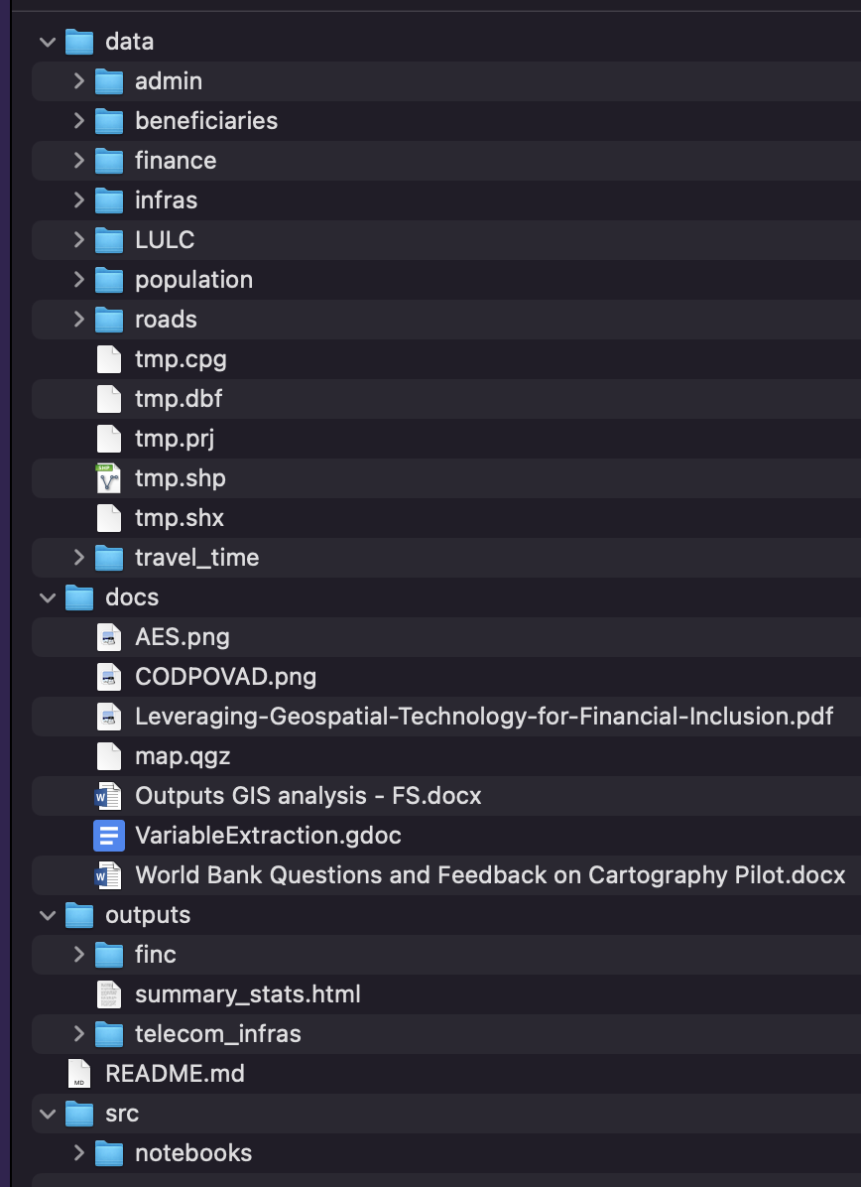
5
Data Management Practices in the BI and Analytics Layer-Cont’d
Data Science Project Setup Best Practices
Separate source code, data, outputs, and documentation
For data, you may even want to separate derived datasets from raw original datasets
Use version control
Emphasize reproducibility
Data
Project documentation
Outputs folder
src version control
Source code

Slide 18
Good Data Management, What Else?
Is there a data management software?
Which vendors to choose?
What about cloud vs. on-premise
Data management books/courses?
Role of people. Does every organization need data manager?

Slide 19
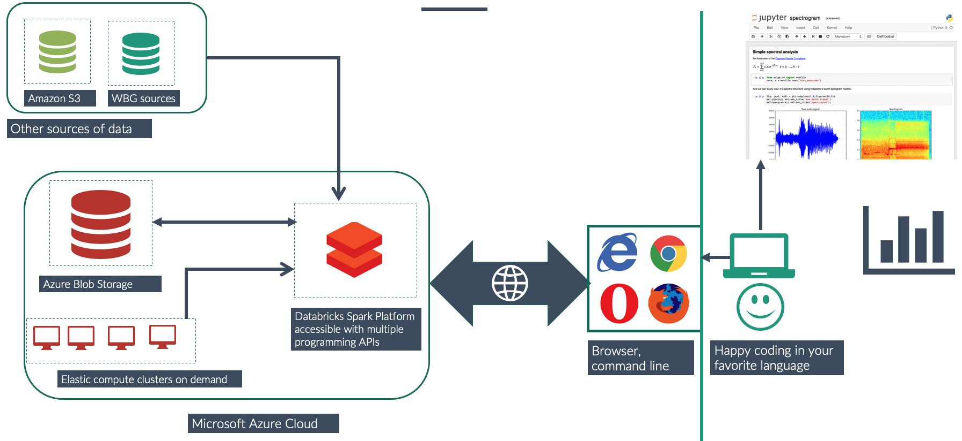
An example infrastructure setup for one of my projects

Slide 20
Thanks and I’m happy to take questions
Email: dmatekenya@worldbankgroup.org

